Slide 1
Yaron Idan
Everybody Gets a Staging Environment
Notes:
Greetings & Introduction
MORE FUN AND COLOR

Slide 3
A little bit about me...
Developer for 15+ years
Working@Soluto
Fell in love with DevOps late 2015
Working with Kubernetes 3+ years

Slide 4
Overview:
New platforms, old problems
Case study
Solving transition pains at scale
Demo
The perks of being DevOps at heart
Notes:
Discussing the defintion of production platforms, the value they hold and the problems they introduce into the development process
A case study of Soluto’s journey adopting a modern production platform - in our case Kubernetes
How we solved the issues we discovered during this time, and made the transition to kubernetes smoother and more fit for future changes
More benefits that we picked up by embracing this method

Slide 5

Photo by Martin Reisch on Unsplash
Notes:
A lot of companies are building platforms for developers to allow them to ship code faster.
Platforms such as kubernetes come with the promise of abstracting away a lot of the concerns of deploying and maintaining our apps in production.
Done right, these tools can allow developers to ship their code much faster, and worry less about how changes done locally will behave when deployed to the platform.

Slide 6

Photo by Markus Spiske on Unsplash
Notes:
A lot of companies are building platforms for developers to allow them to ship code faster.
Platforms such as kubernetes come with the promise of abstracting away a lot of the concerns of deploying and maintaining our apps in production.
Done right, these tools can allow developers to ship their code much faster, and worry less about how changes done locally will behave when deployed to the platform.

Slide 7
Platform - expectations vs reality
 | Expectation | Reality
Transition | Smooth | Rocky
Terminology | Consistent | Novel
Users | Happy | Angry mob
Notes:
Reality, however, tells a different story.
PUT PICTURE
ALSO - Describe a few real world pain points

Slide 8
Platforms@Soluto
Early cloud adopters
Production platform became antiquated
Moving into Docker made kubernetes an obvious choice
Notes:
Briefly cover each part of the slide show

Slide 9
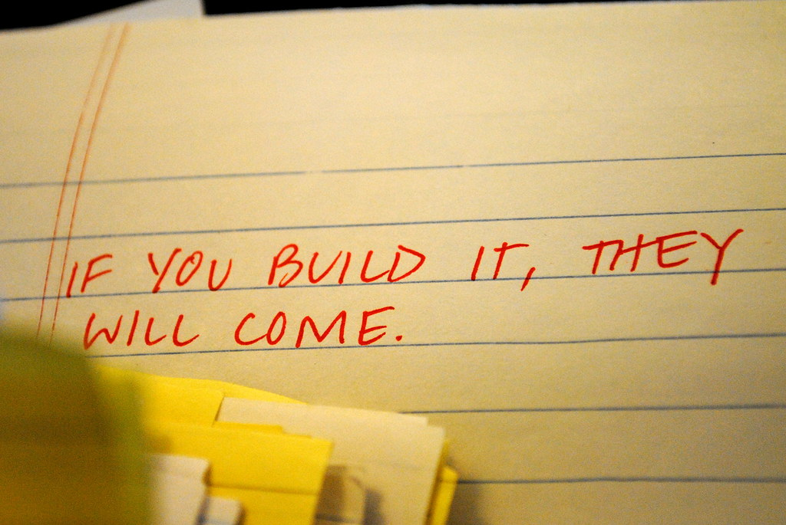
“If you build it they will come” by Katie Taylor is licensed under CC BY 2.0
Notes:
But only if it’s easy to use
Developers were spending a lot of time getting used to the platform
In an agile culture, this pushes people to use familiar solutions instead of spending time on adapting to novel solutions

Slide 10
Automation! Automation!
First step - automating the entire process
Creating a template for reference
What could possibly go wrong?
Notes:
Briefly cover each part of the slide show

Slide 11
Problems keep popping up
Monitoring abstracted by the platform
Secrets for production are not the same as local
Resources are defined differently
Notes:
Infrastructure team becomes a blocker for every issue

Slide 12
How can we solve this?
Deploy the feature branch to production
Empower developers and provide sense of security
Accelerate development cycles and platform adoption
Notes:
Add graph

Slide 13

Notes:
Today I’m going to share a simple method we used here in Soluto that allows developers to spot production issues as early as possible and greatly reduce frustration when developing new features.
This system also allowed for a few unexpected bonuses which I will share with you once the building blocks have been properly understood.

Slide 14
DEMO TIME
Notes:
Architecture slide

Slide 15
Benefits
Ensures fitness for deployment
Eases performance testing
Sharing results with stakeholders earlier
Deploying the entire micro service ecosystem
Notes:
Briefly cover each part of the slide show

Slide 16
Implementation
Github (VCS)
Docker (Configuration as Code)
CodeFresh (CI)
Helm (CD)
Kubernetes (production platform)
Notes:
Add following points of contact -
Github repo
Twitter handle
Slack chanel ADDO
Slideshare

Slide 17
Thanks!
Codefresh & Cloudposse
Everyone at Soluto
Notes:
Briefly cover each part of the slide show

Slide 18
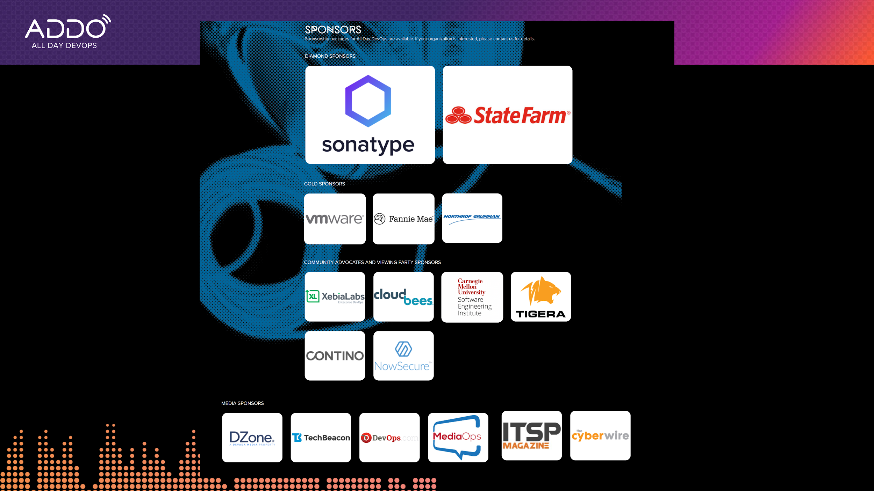
Notes:
Briefly cover each part of the slide show

Slide 19
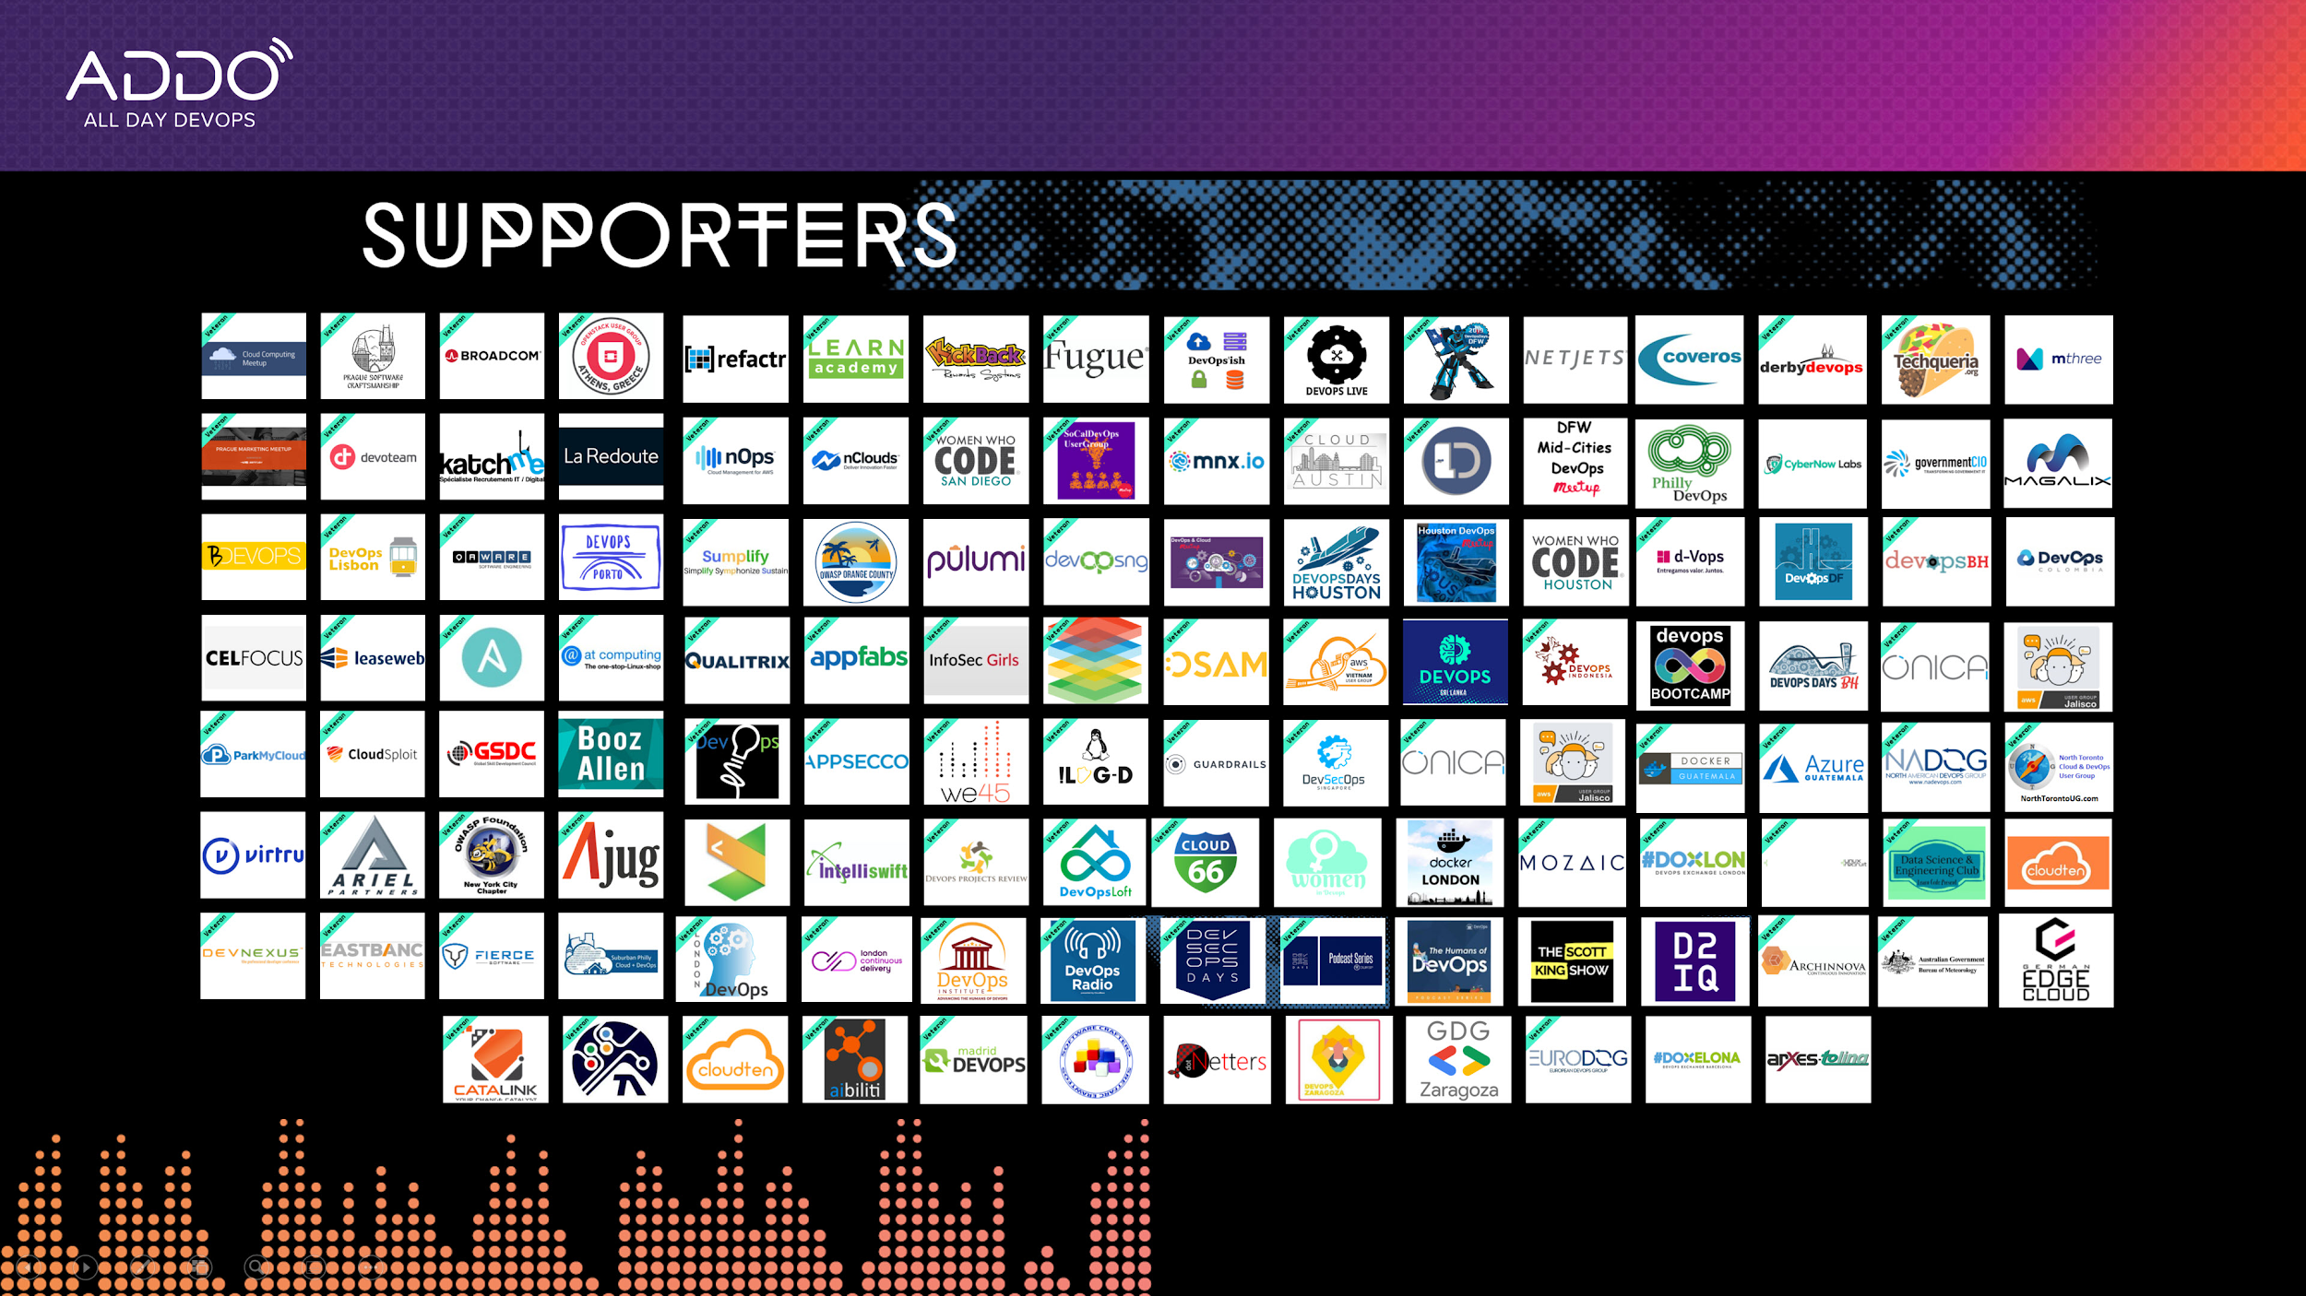

Slide 20
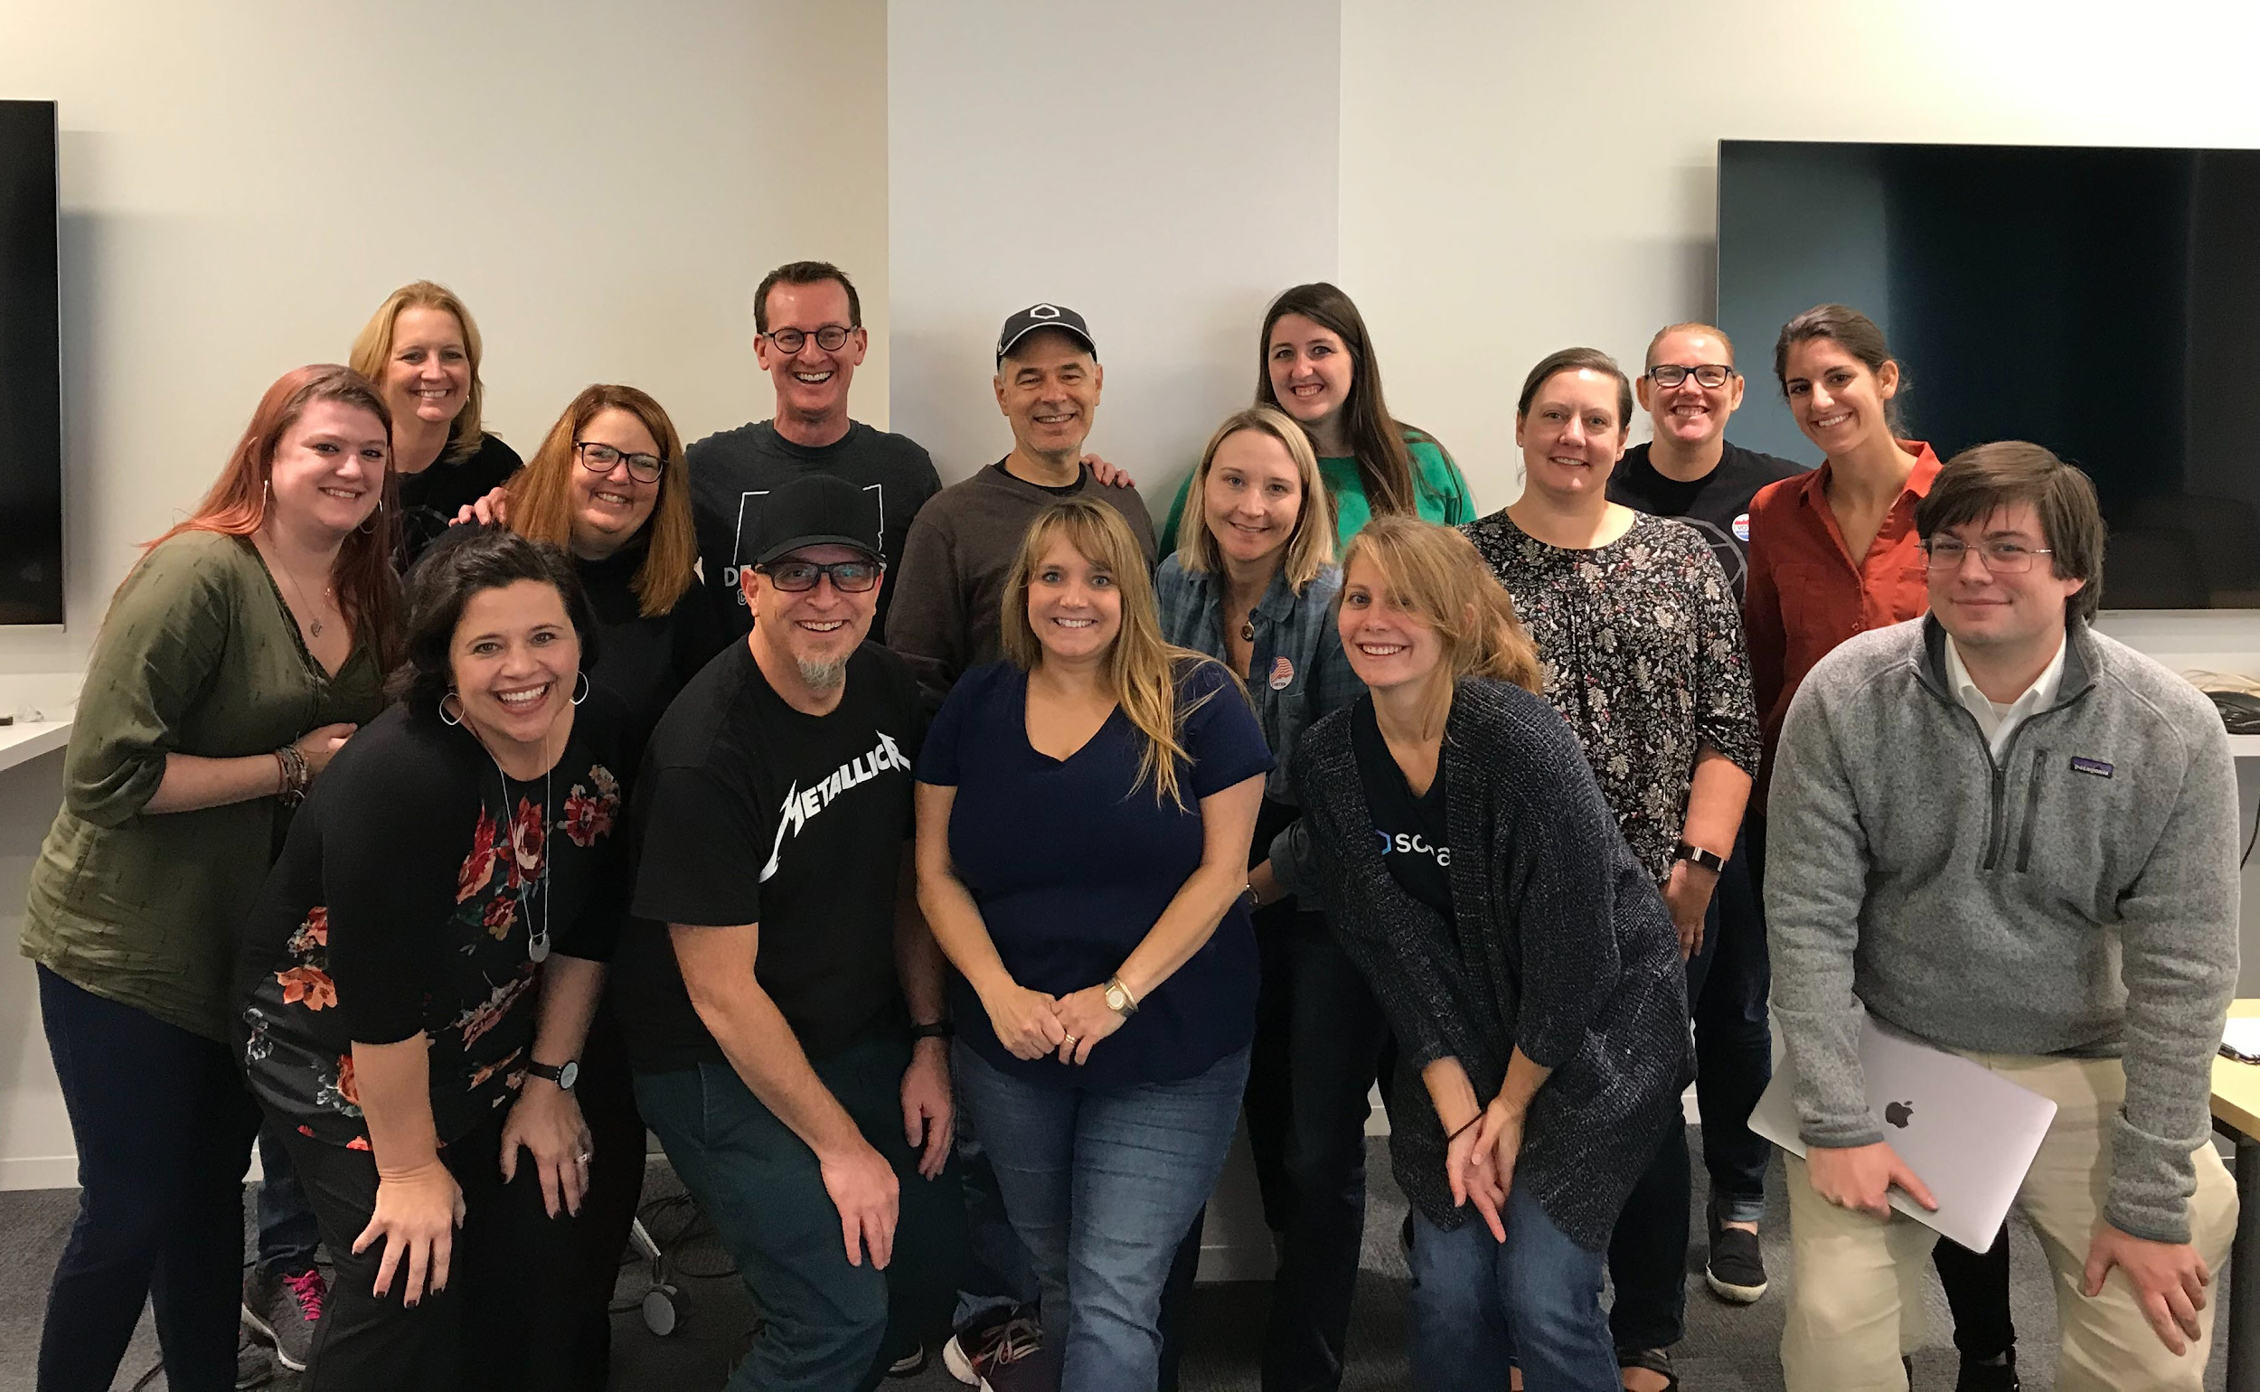

Slide 21




Contact
@yaronidan
yaron-idan
Github repository
#2019addo-ci-cd
Notes:
Briefly cover each part of the slide show

